Slide 1

Amazon Web Services
Gens de Confiance
Lower your infrastructure costs with Spot Instances
Baptiste Gaillard, DevOps - baptiste@gensdeconfiance.fr
Notes:
https://www.olindata.com/en/blog/2018/01/aws-spot-instances-with-on-demand-failover
https://aws.amazon.com/fr/blogs/compute/running-high-scale-web-on-spot-instances/
https://aws.amazon.com/fr/blogs/compute/taking-advantage-of-amazon-ec2-spot-instance-interruption-notices/
https://aws.amazon.com/fr/blogs/aws/new-ec2-spot-instance-termination-notices/
Faire un point sur les Spot Best Practices.
Fonctionnalités non traitées pour le moment :
Parler de la différence “one-time” et “persistent” sur les Spot Requests
Dedicated Tenancy
Le Service Linked Role qui est créé par Amazon pour gérer les instances

Slide 2


AWS Nantes Meetup organizer & speaker
Introduction
Organizer Christophe Lejeune - CEO @ Alfa Safety
Speaker Baptiste Gaillard - DevOps @ Gens De Confiance

Slide 3

Gens de Confiance
Introduction
Notre Manifesto Nous pensons que seule la confiance permettra de rebâtir la société.
Nous sommes Un site simple et efficace de petites annonces sécurisées, accessible uniquement sur recommandation.
Le principe Pour rejoindre le réseau il vous faudra obtenir la recommandation de 3 parrains, qui se portent moralement garant pour vous auprès des autres membres. Lorsque la confiance est là, un cercle vertueux s'installe rapidement, alimentant bienveillance et courtoisie dans les relations et les échanges entre les membres.
Notes:
TODO:
Indiquer les profils tech que nous recherchons en ce moment
Encourager les gens à venir s’inscrire sur GensDeConfiance

Slide 4
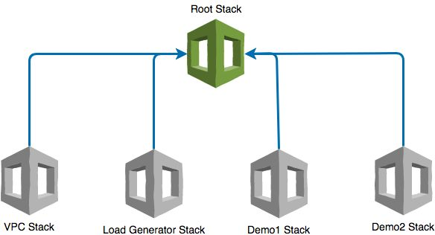
Presentation plan
General concepts
Spot Instance Pools
Interruptions
Cost Savings
Pricing History
Features
Spot Instance Requests
Spot Fleets
Demo : Map / Reduce like program
EC2 Fleets (released May 2018)
ASG with multiple purchasing options (released November 2018)
Use case : Website with Load Balancing
Use cases at Gens De Confiance
Jenkins Cluster
Staging and development environments
Demos are provisioned with the following AWS Cloud Formation stacks

Slide 5
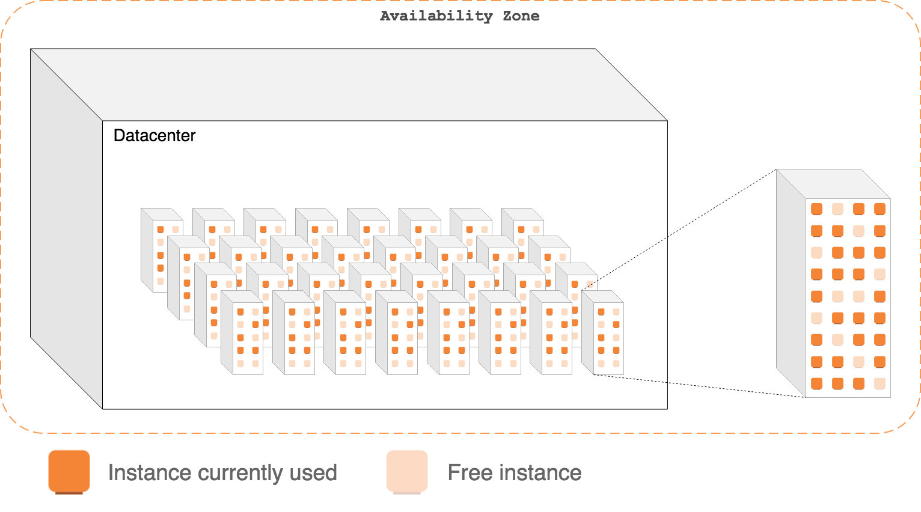
Spot Instances
1. General Concepts
Spot Instance : an unused EC2 instance that is available for less than the On-Demand price.
Savings of up to 90% the On-Demand price

Slide 6
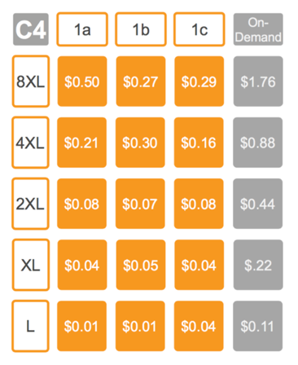
Spot Instance Pool
1. General Concepts
Spot Instance Pool : A set of unused EC2 instances with the same instance type, operating system, Availability Zone, and network platform.
Sample Pool {c4.large,Linux,eu-west-1a,VPC}
Source : Roshni’s Pary, AWS News Blog

Slide 7
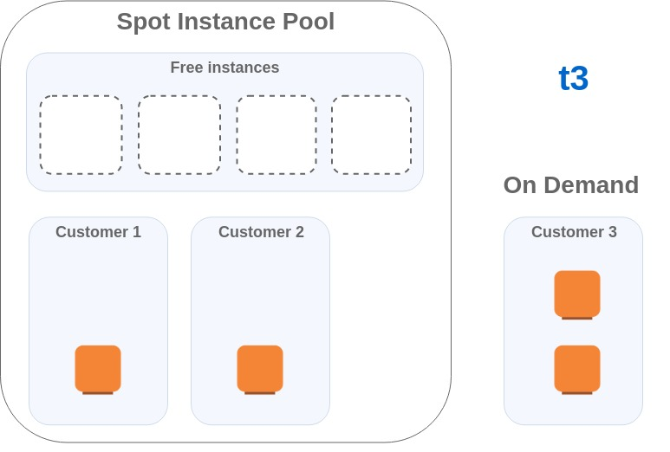
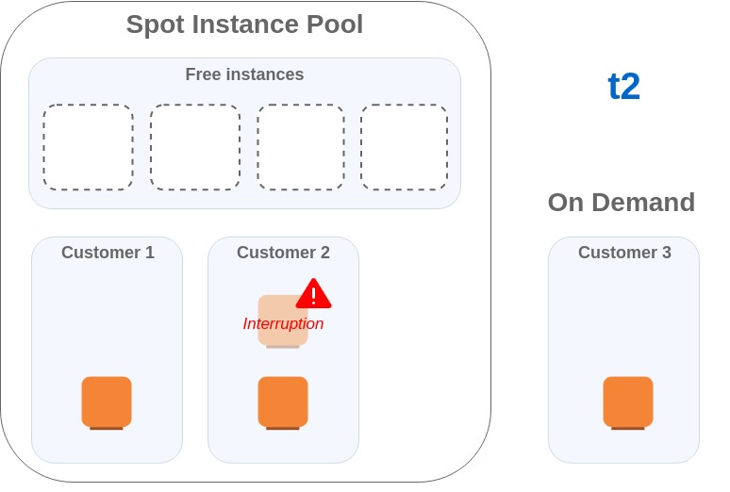
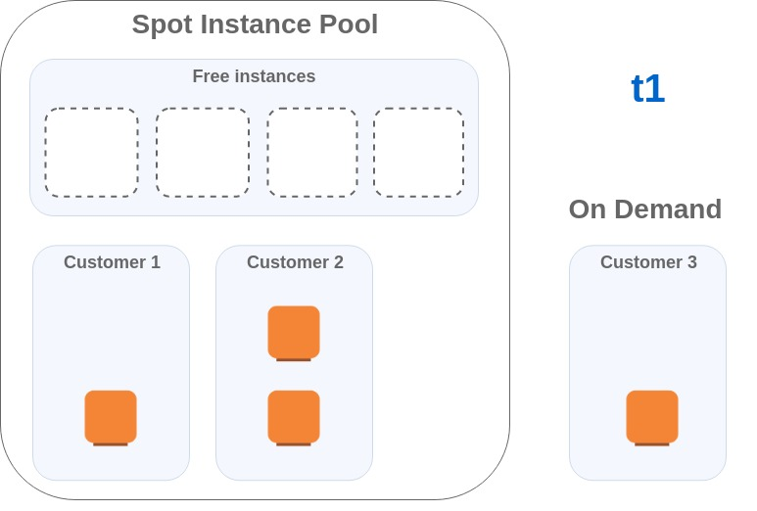
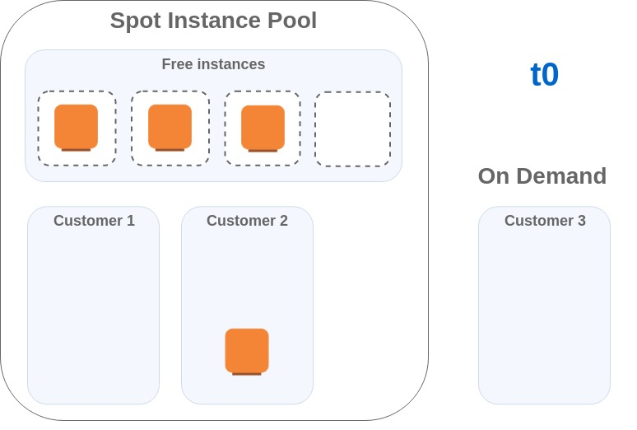
Interruptions
1. General Concepts
At any time a Spot Instance can be stopped by Amazon because it’s requested by another customer with another purchasing option (On-Demand for example)
Spot Instance Pools do not have the same frequencies of interruptions → Use the Spot Instance Advisor

Slide 8
Cost savings
1. General Concepts
Saving up to 90% the On-Demand price
Sometimes cost is even lower than Reserved Instances
Sometimes cost is same as On-Demand
Instance Type | On-Demand | 1 year All Upfront | 3 year All Upfront | Spot price
t3.large | 0,0944 $ | 0,062 $ | 0,042 $ | 0,0944 $
m5.large | 0,112 $ | 0,073 $ | 0,048 $ | 0,0318 $
c5.large | 0,101 $ | 0,065 $ | 0,042 $ | 0,0303 $
* Paris region (eu-west-3), Spot price date 2019-02-04
Notes:
Tableau basé sur la région Paris, prix prélevés le 4 Février 2019.

Slide 9
Pricing history
1. General Concepts
The spot price associated to an Instance Pool changes over time
Spot prices fluctuate depending on supply and demand
View pricing history : Web Console, CLI or SDK
Notes:
make slide11

Slide 10
2. Features
Spot Instance Requests
Spot Fleets
Demo : Map / Reduce like program
EC2 Fleets (released May 2018)
ASG with multiple purchasing options (released November 2018)
Use case : Website Load Balancing

Slide 11
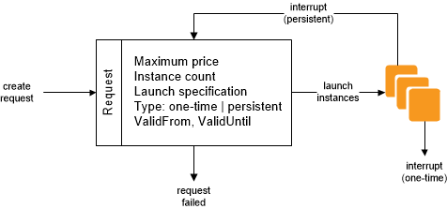
Spot Instance requests
2. Features

Slide 12
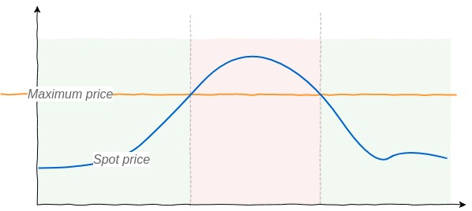
Spot Instance requests
2. Features
If your maximum price exceeds the current Spot price, Amazon EC2 fulfills your request immediately if capacity is available.
Otherwise, Amazon EC2 waits until your request can be fulfilled or until you cancel the request.
Bidding is not required since March 2018
Notes:
make spot-requests
https://aws.amazon.com/blogs/compute/new-amazon-ec2-spot-pricing/

Slide 13
Spot Fleet Requests
2. Features
A configuration which describes
A target capacity ;
One or more Launch Specifications (or Launch Templates) for the instances to start ;
The maximum price you are willing to pay.
Amazon EC2 attempts to maintain your Spot Fleet's target capacity as Spot prices change.

Slide 14
Spot Fleet Request - Type
2. Features
request : One-time request for your desired capacity
Target capacity cannot be modified ;
Spot does not attempt to replenish Spot Instances if capacity is diminished ;
If capacity is not available, Spot Fleet does not submit requests in alternative Spot pools.
maintain : Maintain a target capacity over time
Launches replacement instances when Spot price of Spot Pools change ;
Supports Health Check replacement ;

Slide 15
Spot Fleet Requests - AllocationStrategy
2. Features
lowestPrice The Spot Instances come from the pool with the lowest price. This is the default strategy.
diversified The Spot Instances are distributed across all pools.
instancePoolsToUseCount The Spot Instances are distributed across the number of Spot pools that you specify. This parameter is valid only when used in combination with lowestPrice.
Notes:
Mises en garde importantes :
Ces choix dépendent évidemment du use case
Attention aux placements dans une seul AZ !

Slide 16
Spot Fleet Requests - Auto-Scaling
2. Features
Increase or decrease the target capacity of your Spot Fleet automatically based on the demand
3 types of scaling
Target Tracking Scaling Scale automatically to keep a specific target value for a specific metric
Step Scaling Increase or decrease the current capacity of the fleet based on a set of scaling adjustments, known as step adjustments, it varies based on the size of the alarm breach.
Scheduled Scaling Increase or decrease target capacity based on the date and time

Slide 17
Demo
Joe works for a translation company. His boss asked him to make a commercial proposition for one of their customers
The customer would like to translate 1 million English text documents
Joe needs to count the words in a short time period
To make a realistic commercial proposition, statistics about the words corpus are needed
The company cannot afford to pay too much for doing this

Slide 18
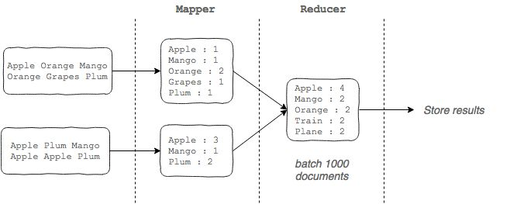
Demo - Map-Reduce like program
2. Features
Notes:
https://docs.aws.amazon.com/AWSEC2/latest/UserGuide/spot-requests.html
DEMO : Comptage de mots : http://www.anc.org/
http://ai.stanford.edu/~amaas/data/sentiment/
http://kdd.ics.uci.edu/databases/reuters21578/reuters21578.html
http://www.science.smith.edu/dftwiki/index.php/Hadoop_Tutorial_2_--_Running_WordCount_in_Python

Slide 19
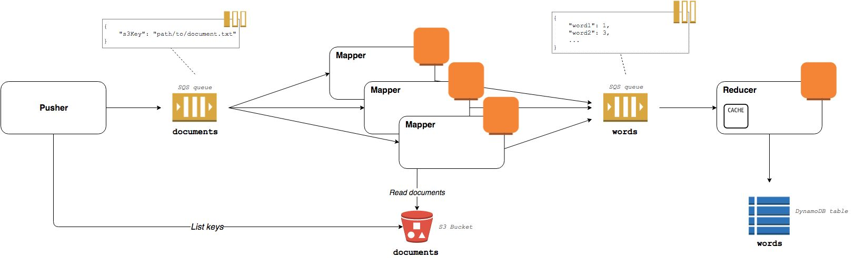
Demo - Words count
2. Features
Notes:
https://docs.aws.amazon.com/AWSEC2/latest/UserGuide/spot-requests.html
DEMO : Comptage de mots : http://www.anc.org/
http://ai.stanford.edu/~amaas/data/sentiment/
http://kdd.ics.uci.edu/databases/reuters21578/reuters21578.html
http://www.science.smith.edu/dftwiki/index.php/Hadoop_Tutorial_2_--_Running_WordCount_in_Python

Slide 20
Spot instances - Interruptions
2. Features
You must ensure that your application is prepared for a Spot Instance interruption.
Amazon EC2 might interrupt your Spot Instances in 3 cases
Price : The Spot price is greater than your maximum price
Capacity : There are not enough unused EC2 instances to meet the demand
Constraints : If your request includes a constraint such as a launch group or an Availability Zone group, these Spot Instances are terminated as a group when the constraint can no longer be met.
Interruption behaviors « hibernate », « stop » or « terminate » (default)
Stopped or Hibernated instances can only be restarted by Spot Fleet (not manually)
Hibernate mode does not wait 2 minutes before hibernation
EC2 sends an interruption notice 2 minutes before the interruption
Notes:
Exemple de use case pour le stop et l’hibernation : Calculs scientifiques ou traitements pour lesquels les arrêts lorsque le prix Spot augment n’est pas problématique. Reprise transparente quand le prix Spot redescend.
https://eksworkshop.com/spot/simulateinterrupt/interrupt/
https://github.com/awslabs/ec2-spot-labs/tree/master/workshops/ec2-spot-fleet-web-app

Slide 21
Spot instances - Manage interruptions
2. Features
Using a CloudWatch event
{
"version": "0",
"id": "12345678-1234-1234-1234-123456789012",
"detail-type": "EC2 Spot Instance Interruption Warning", "source": "aws.ec2", "account": "123456789012", "time": "yyyy-mm-ddThh:mm:ssZ", "region": "us-east-2", "resources": [ "arn:aws:ec2:us-east-2:123456789012:instance/i-1234567890abcdef0" ], "detail": {
"instance-id": "i-1234567890abcdef0",
"instance-action": "action"
}
}

Slide 22
Spot instances - Manage interruptions
2. Features
Using EC2 instance metadata
# Polling each 5 seconds curl http://169.254.169.254/latest/meta-data/spot/instance-action { "action": "terminate", "time": "2017-09-18T08:22:00Z" }

Slide 23
Use case
Very low cost website with additional constraints
Auto-Scaling based on traffic
Highly Available

Slide 24
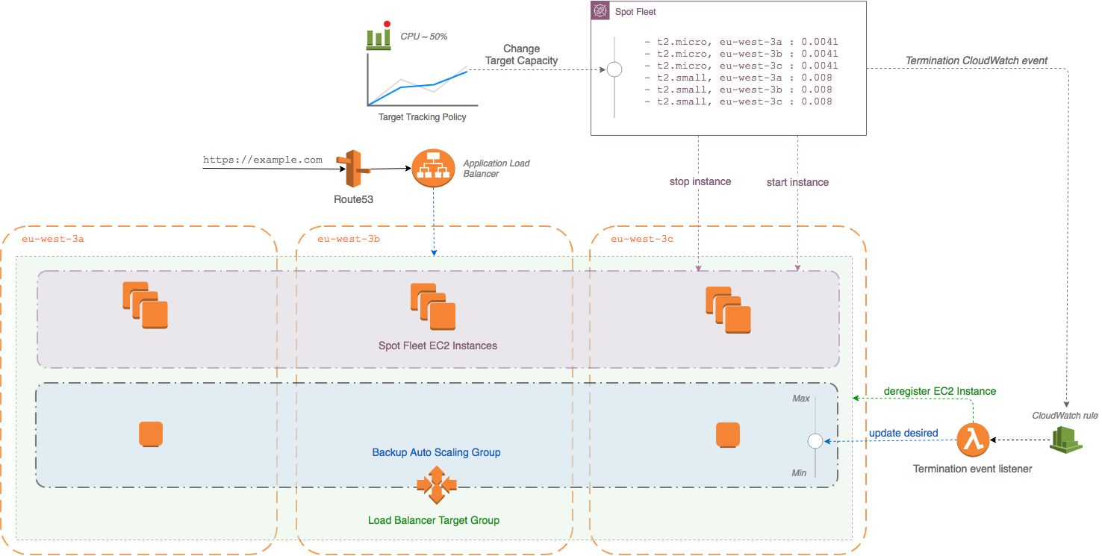
Spot Fleet Requests
2. Features
Notes:
Propriétés communes :
Date d’expiration
Annulation manuelle
Spot Fleet Instance Weighting
Modification de la Target Capacity (exemple sur consommation de file SQS qui se rempli), dire qu’il n’est pas possible de modifier la portion à la demande
https://eksworkshop.com/spot/simulateinterrupt/interrupt/
https://github.com/awslabs/ec2-spot-labs/tree/master/workshops/ec2-spot-fleet-web-app

Slide 25
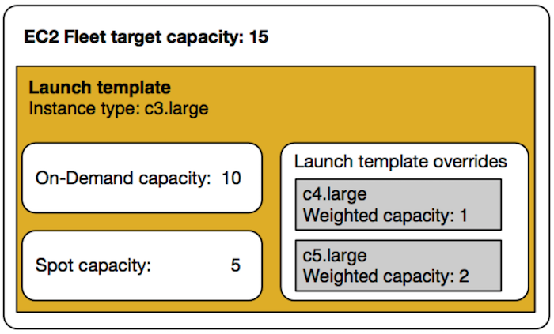
EC2 Fleets - released May 2018
2. Features
Supports placement in multiple AZs
Available only through CLI or API
Support Health Checks
Dynamic updates
« TotalTargetCapacity »
« OnDemandTargetCapacity »
« SpotTargetCapacity »
Notes:
TODO: Etre capable d’expliquer
Les Weighted capacity

Slide 26
Auto Scaling Groups with multiple purchasing options - released November 2018
2. Features
Instances Distribution | 10 | 20
Example 1
On-Demand base: 10 | 10 | 10
On-Demand percentage above base: 50% | 0 | 5
Spot percentage: 50% | 0 | 5
Example 2
On-Demand base: 0 | 0 | 0
On-Demand percentage above base: 60% | 6 | 12
Spot percentage: 40% | 4 | 8

Slide 27
3. Use cases at Gens de Confiance
Jenkins Cluster
Staging and development environments

Slide 28
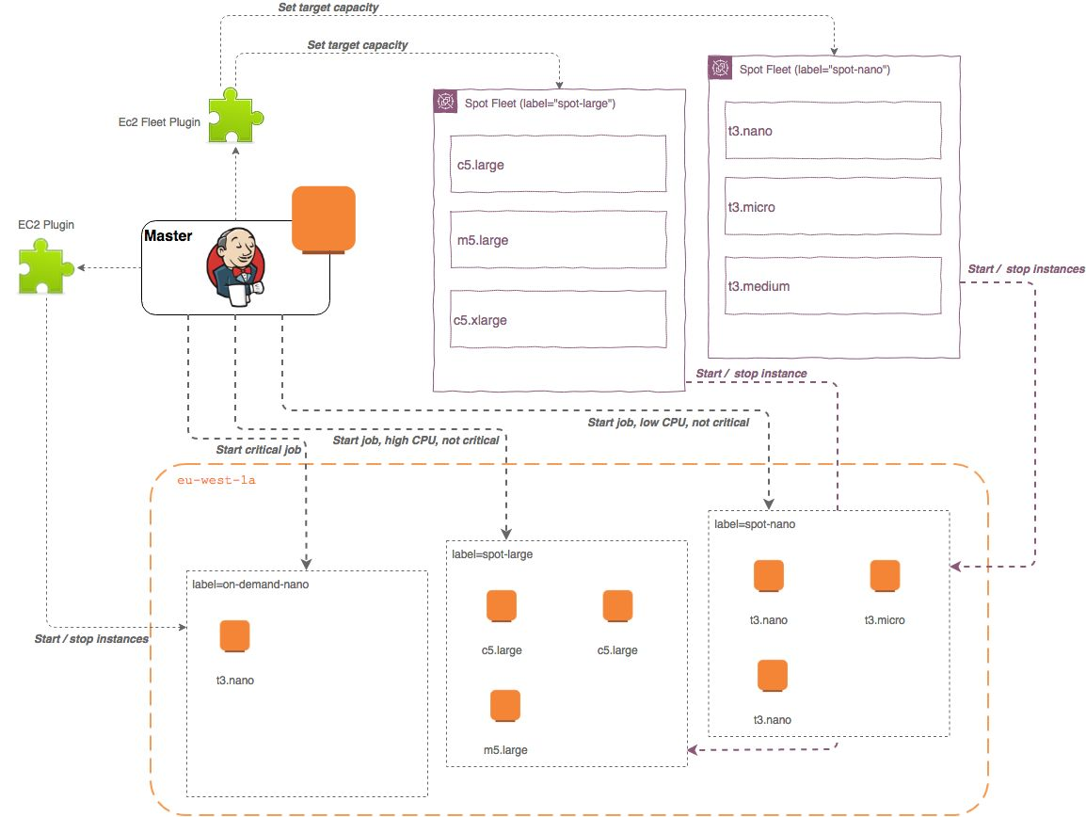
Jenkins Cluster
3. Use cases at Gens de Confiance

Slide 29
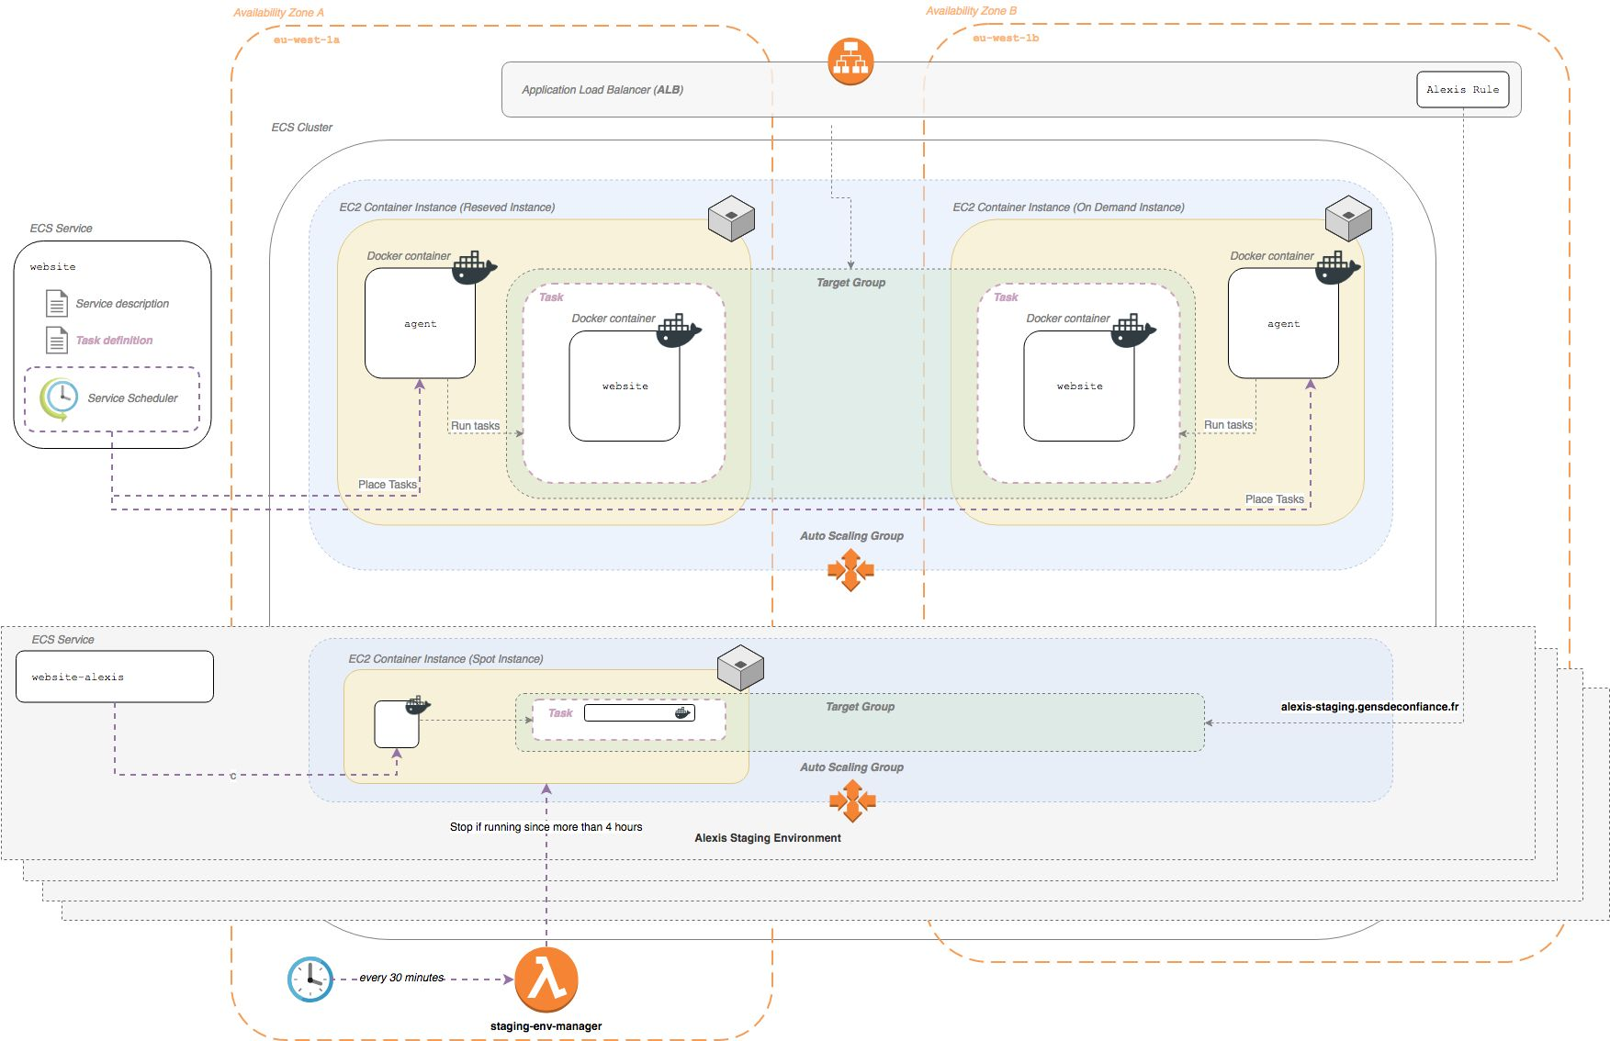
Staging and development environments
3. Use cases at Gens de Confiance

Slide 30
Going further
Spot is integrated in other AWS services
ECS (Elastic Container Service)
EMR (Elastic Map Reduce)
AWS Batch
AWS Data Pipeline
AWS documentation
https://aws.amazon.com/ec2/spot/getting-started/
https://aws.amazon.com/fr/ec2/spot/instance-advisor/
Services provided by other companies
Spotinst : https://spotinst.com
AutoSpotting : https://autospotting.org

Slide 31




Merci !
Any questions ?
Contact me
Baptiste Gaillard DevOps @ GensDeConfiance
baptiste@gensdeconfiance.fr
@baptigaillard
linkedin.com/in/baptistegaillard

Slide 32
BACKUP SLIDES
Gens de Confiance
The following slides will not be presented during the Meetup
Notes:
https://www.olindata.com/en/blog/2018/01/aws-spot-instances-with-on-demand-failover
https://aws.amazon.com/fr/blogs/compute/running-high-scale-web-on-spot-instances/
https://aws.amazon.com/fr/blogs/compute/taking-advantage-of-amazon-ec2-spot-instance-interruption-notices/
https://aws.amazon.com/fr/blogs/aws/new-ec2-spot-instance-termination-notices/
Fonctionnalités non traitées pour le moment :
Parler de la différence “one-time” et “persistent” sur les Spot Requests
Dedicated Tenancy
Le Service Linked Role qui est créé par Amazon pour gérer les instances

Slide 33
Spot Instance requests - Creation
2. Features
CLI
SDK
# Persistent request $ aws ec2 request-spot-instances --instance-count 3 --spot-price 0.002 --type "persistent" --launch-specification file://spot-request.json # One time request $ aws ec2 request-spot-instances --instance-count 3 --spot-price 0.0041 --type "one-time" --launch-specification file://spot-request.json
import boto3
ec2_client = boto3.client('ec2')
response = ec2_client.request_spot_instances(
AvailabilityZoneGroup='string',
BlockDurationMinutes=60,
ClientToken='string',
DryRun=False,
InstanceCount=3,
LaunchGroup='string',
LaunchSpecification=launch_specification,
SpotPrice='0.02',
Type='one-time'|'persistent',
ValidFrom=datetime(2015, 1, 1),
ValidUntil=datetime(2015, 1, 1),
InstanceInterruptionBehavior='terminate'
)
Web Console
Web Console
Notes:
make slide13-1
make slide13-2
make slide13-3

Slide 34
1. General Concepts
Spot Instance Pools
Cost savings
Pricing history

Slide 35
Instance purchasing options
On-Demand Instances Pay, by the second, for the instances that you launch.
Reserved Instances Purchase, at a significant discount, instances that are always available, for a term from one to three years.
Scheduled Instances Purchase instances that are always available on the specified recurring schedule, for a one-year term.
Spot Instances Request unused EC2 instances, which can lower your Amazon EC2 costs significantly.
Dedicated Hosts Pay for a physical host that is fully dedicated to running your instances, and bring your existing per-socket, per-core, or per-VM software licenses to reduce costs.
Dedicated Instances Pay, by the hour, for instances that run on single-tenant hardware.
Capacity Reservations Reserve capacity for your EC2 instances in a specific Availability Zone for any duration.

Slide 36
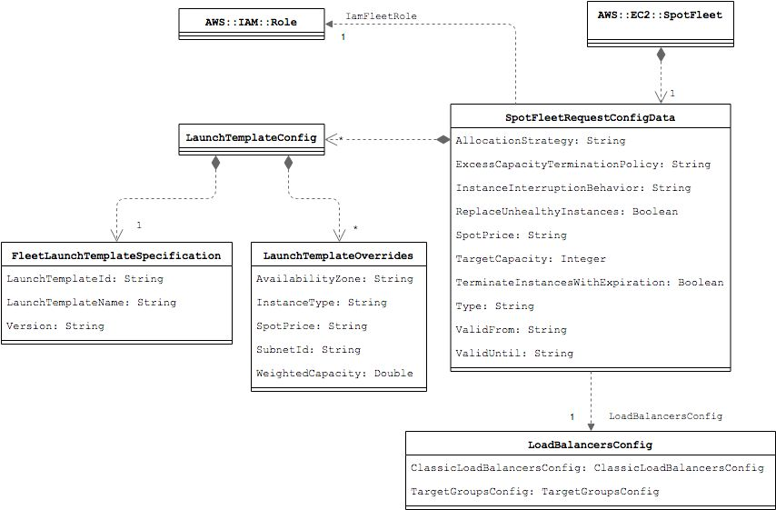
Spot Fleet Requests
2. Spot Instances
Notes:
Attention il manque des choses car tout n’est pas supporté par CloudFormation : https://docs.aws.amazon.com/AWSEC2/latest/APIReference/API_SpotFleetRequestConfigData.html
Propriétés communes :
Date d’expiration
Annulation manuelle
Spot Fleet Instance Weighting
Modification de la Target Capacity (exemple sur consommation de file SQS qui se rempli), dire qu’il n’est pas possible de modifier la portion à la demande
Stratégie d’allocation
Description des états
ExcessCapacityTerminationPolicy :« noTermination » or « default »
InstanceInterruptionBehavior :« hibernate », « stop » or « terminate »
OnDemandAllocationStrategy, OnDemandFullfilledCapacity, OnDemandTargetCapacity : « lowestPrice » or « prioritized »
ReplaceUnhealthyInstances : Status health every 2 minutes, considered unhealthy after 3 consecutive health checks
TerminateInstancesWithExpiration :Indicate if expired instances should be terminated.

Slide 37
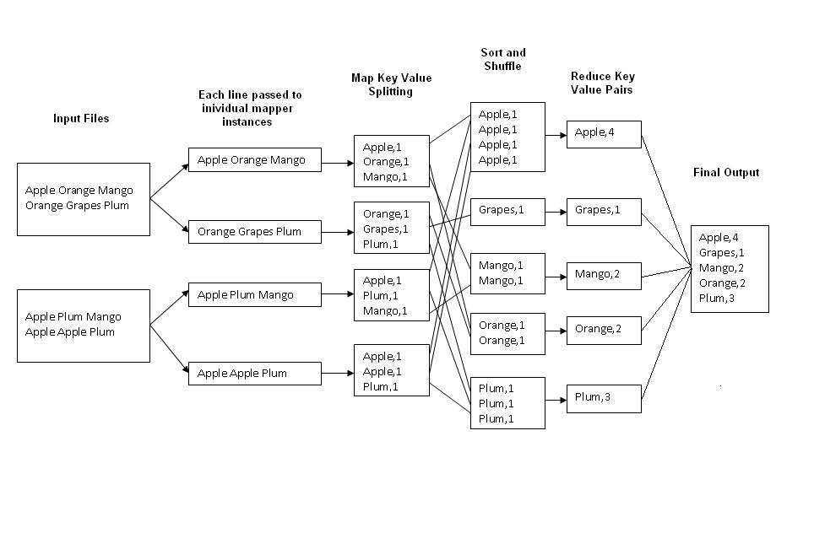
Demo - Map-Reduce like program
2. Spot Instances
Notes:
http://kickstarthadoop.blogspot.com/2011/04/word-count-hadoop-map-reduce-example.html

Slide 38
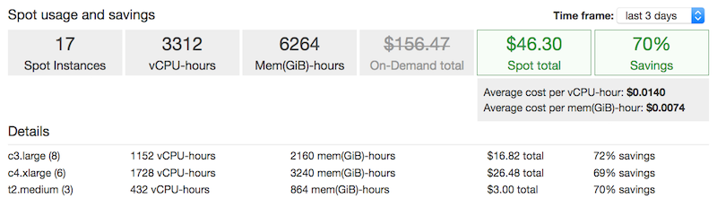
Demo - Costs savings
2. Spot Instances
Web Console
Notes:
Tableau basé sur la région Paris, prix prélevés le 4 Février 2019.

Slide 39
Demo - Conclusions
2. Spot Instances
Pros
Low cost
Allows our company to start powerful servers
Cons
At any time Amazon could stop our instances

Slide 40
Spot Instance requests - Spot Blocks
2. Spot Instances
Spot Instances with a specified duration ;
Designed not to be interrupted and will run continuously for the duration you select ;
In rare situations, Spot blocks may be interrupted due to Amazon EC2 capacity needs. In these cases, we provide a two-minute warning before we terminate an instance, and you are not charged for the terminated instances even if you used them ;
Possible durations : 1, 2, 3, 4, 5 or 6 hours ;
Price depends on the specified duration ;
Price remains in effect until the instance terminates.

Slide 41
Other features
2. Spot Instances
CloudWatch Metrics ;
Dedicated Tenancy ;
Data Feed ;

Slide 42
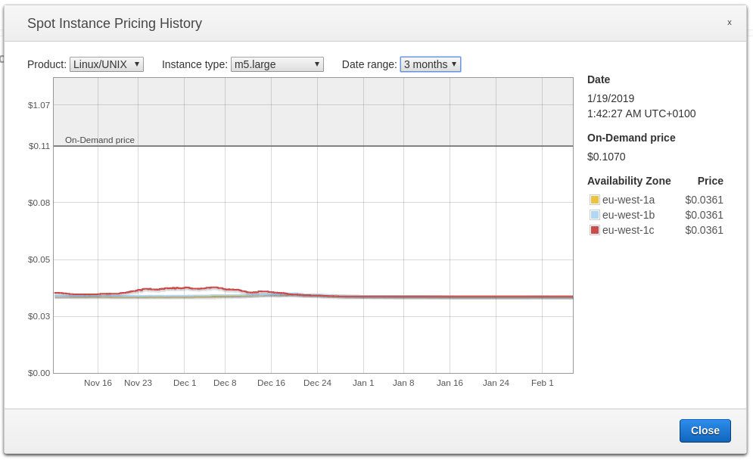
Pricing history
1. General Concepts
CLI
SDK
$ aws ec2 describe-spot-price-history --instance-types m5.large --product-description "Linux/UNIX (Amazon VPC)" --start-time 2019-02-06T09:00:00 --end-time 2019-02-06T15:00:00
{
"SpotPriceHistory": [ {
"Timestamp": "2019-02-05T13:34:22.000Z",
"AvailabilityZone": "eu-west-1a",
"InstanceType": "m5.large",
"ProductDescription": "Linux/UNIX",
"SpotPrice": "0.036100"
}, ...
] }
import boto3
ec2_client = boto3.client('ec2')
response = ec2_client.describe_spot_price_history(
InstanceTypes=[
'm5.large'
],
ProductDescriptions=[
'Linux/UNIX (Amazon VPC)'
],
StartTime=datetime(2019, 2, 6, 9, 0, 0),
EndTime=datetime(2019, 2, 6, 15, 0, 0)
)
Web Console
Web Console
Notes:
make slide11

Slide 43
Limits
2. Spot Instances

Slide 44
Useful tools
2. Spot Instances

Slide 45
Paid services

